Slide 1
Interactive Multi-perspective Imagery from Photos and Videos
Henrik Lieng^{1,2} James Tompkin¹ Jan Kautz¹
University College London¹ University of Cambridge²

Slide 2
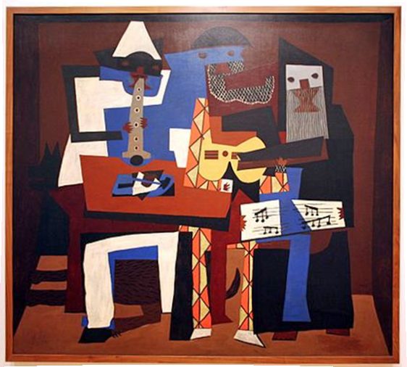
Multi-perspective Imagery - Picasso
Notes:
Pablo Picasso
Three Musicians (1921)
At MoMA in New York !

Slide 3
Multi-perspective Imagery - Hockney
Notes:
Joiner or collage: The Desk (1984)
David Hockney

Slide 4
Multi-perspective Imagery - Escher
Notes:
M.C. Escher (Maurits Cornelis)
Waterfall (1961)

Slide 5
Multi-perspective Imagery - Gonsalves
Notes:
Rob Gonsalves
Tree House In Autumn (1995)

Slide 6
Multi-perspective Imagery - Head
Notes:
Clive Head
Piccadilly (2007)

Slide 7
Single-perspective images may not reveal enough information
Notes:
Motivation: single-perspective images does not always show ‘enough’ information about the scene.
For example: what is behind the two corners?

Slide 8
Solved by multi-perspective imagery
Notes:
This is solved by multi-perspective imagery

Slide 9
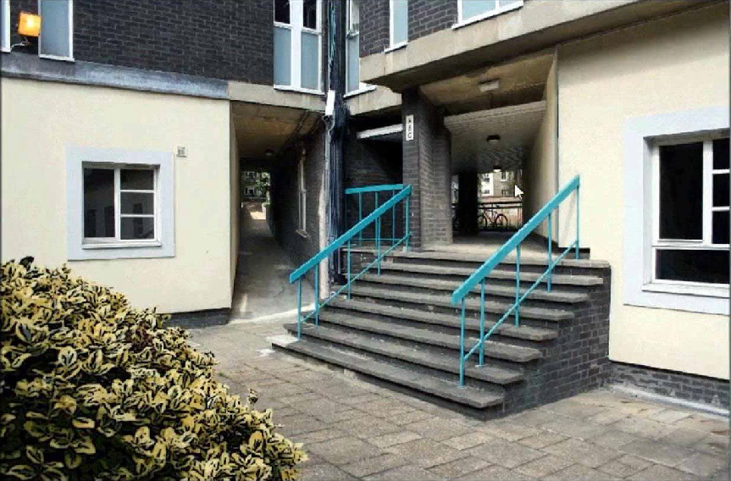
Solved by multi-perspective imagery

Slide 10
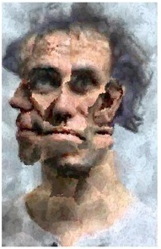
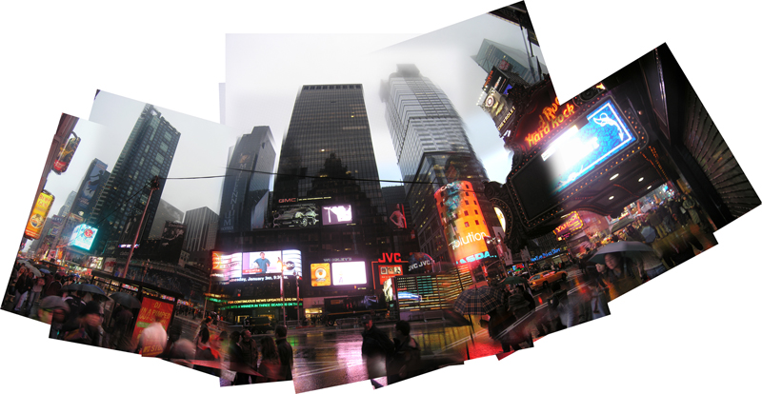
Existing work focuses on specific aspects
[Brown and Lowe, 2007]
[Collomosse
and Hall, 2003]
[Nomura
et al., 2007]
[Agarwala et al., 2006]

Slide 11
Notes:
…. As well as looking around corners, we can look down stair cases…

Slide 14
Notes:
… changing the perspective projection

Slide 16
We support any kind of perspective transformation
Notes:
… and a combination of them….

Slide 17
Recursive multi-perspective imagery

Slide 18
Our system

Slide 19
Prototype Interface
Notes:
So how do we do this?

Slide 20
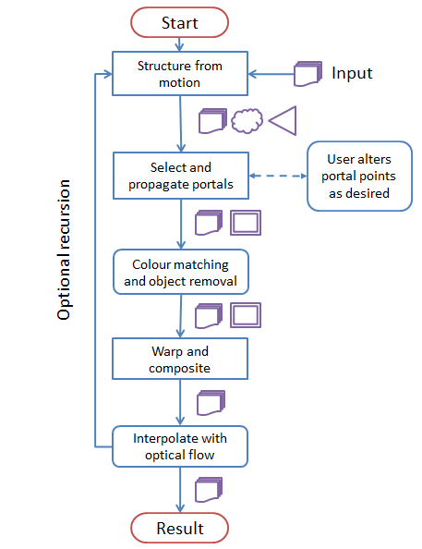
Overview
Code and data available online

Slide 21
Calibration (Structure from Motion)
Bundler for photographs [Snavely et al., 2006]
Voodoo camera tracker for videos [Thormählen, 2006]
Outputs 3D point cloud and camera parameters.

Slide 22
Portal propagation
Find portal vertices in 3D
In the target image, project 3D points from SfM
For each portal vertex, find the 5 closest projected points,
Then, select the closest point in 3D to camera
Project 3D portal vertices into the other images
Ensures that we use a visible 3D point.
User can adjust poor propagations manually.

Slide 23
Portal propagation

Slide 24
Portal propagation
Find portal vertices in 3D
In the target image, project 3D points from SfM
For each portal vertex, find the 5 closest projected points,
Then, select the closest point in 3D to camera
Project 3D portal vertices into the other images
Ensures that we use a visible 3D point.
User can adjust poor propagations manually.

Slide 25
Warp and composite

Slide 26
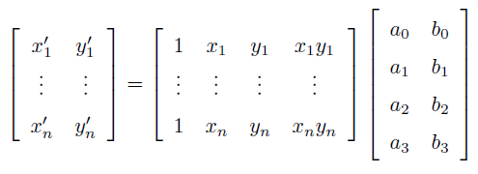
Warp and composite
For each point (x,y) in a propagated portal, move to (x’,y’):
x’ = a₀ + a₁x + a₂y + a₃xy
y’ = b₀ + b₁x + b₂y + b₃xy
Looking at our bilinear map:
Lines roughly map to lines.
Parallelism is not preserved.
Use α-blending when compositing.

Slide 27
Warp interpolation (optical flow)
No interpolation
With interpolation

Slide 28
Warp interpolation (optical flow)
SIFT flow [Liu et al., 2011]
Robust to illumination changes.
Slow (1 minute for 1MP portals).
Use real-time GPU optical flow algorithms for more ‘interactiveness’.
E.G., [Pauwels and Van Hulle, 2008]
Notes:
We support two interpolation schemes: bi-directional and linear. More details in the paper

Slide 29
Colour matching
Use [Reinhard et al., 2001].
Only colour match similar regions (e.g., walls to walls).

Slide 30
Object Removal

Slide 31
System recap:
Code and data available online

Slide 32
Evaluation
Interviews with professional artists (2D/3D).
Positive towards the novelty of the results.
Positive towards speed improvement.
Popping artefacts not distracting.
Compared to artists’ current systems:
Produces as good or better results.
Is easier and faster to use.
Notes:
Evaluation:
Artists positive to the system:
5 interviews with professional artists were conducted
Several minutes with Photoshop compared to just a few seconds with our system
They were enthusiastic about the results: popping artefacts were not distracting in from their point of view (it’s kind of expected)
Only way to convince an artist to use a new system is to demonstrate that: it’s capable of producing as good or better results and is easier and faster to use than current systems
-> we believe we demonstrate this
For more details about evaluation we refer to the paper

Slide 33
Multi-perspective imagery from videos
Notes:
We support video as well
Two types

Slide 34
Notes:
Demonstrate faster system
Matlab system and datasets available online
Future work: Google street view

