Slide 1
Interactive Facades Analysis and Synthesis of Semi-Regular Facades
Sawsan AlHalawani
Yong-Liang Yang
Han Liu
Niloy J. Mitra

Slide 2
Sawsan AlHalawani
Notes:
Building facades are integral to most urban environments. They are created with different types of repeated elements and have different arrangements.
Usually, facades get modified over time with windows opened or closed,
Exterior elements such as curtains and flower pots are included leading to geometric variations which poses challenges to stat-of-the-art façade analysis methods.

Slide 3
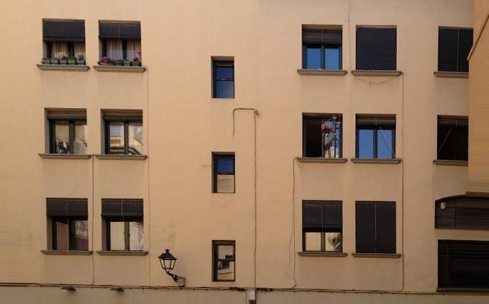
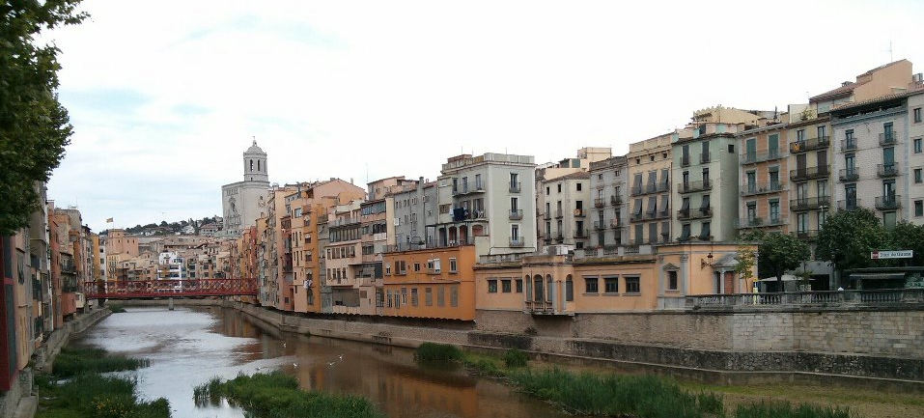
Introduction
Notes:
Building facades are integral to most urban environments. They are created with different types of repeated elements and have different arrangements.
Usually, facades get modified over time with windows opened or closed,
Exterior elements such as curtains and flower pots are included leading to geometric variations which poses challenges to stat-of-the-art façade analysis methods.

Slide 4
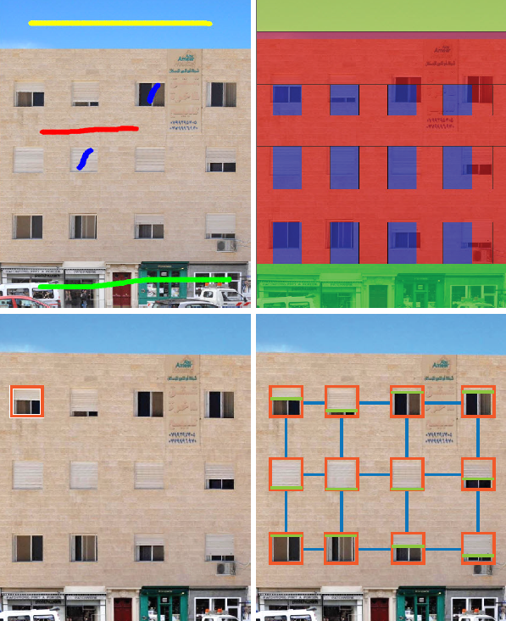
Motivation
[Teboul et al. 2011]
[Our work]
Notes:
Current methods assume the repeated elements to be similar which causes a failure in the detection with the presence of variations as shown in the figure above produced using GraPes software
Our goal targets façade images with element variations mainly opening or closing of windows..

Slide 5
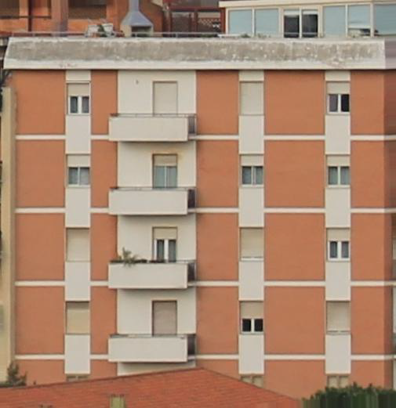
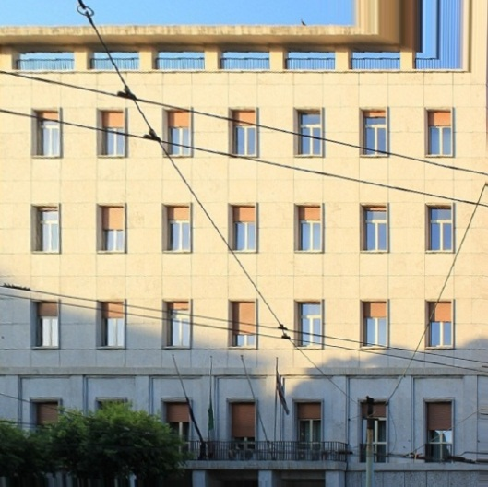
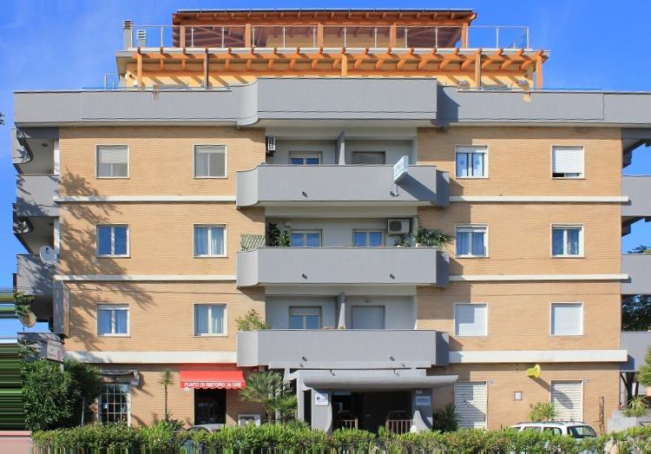
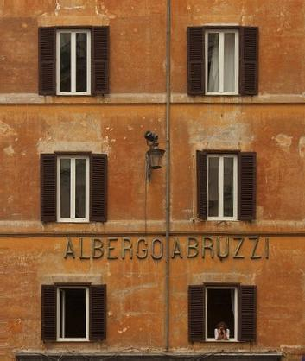
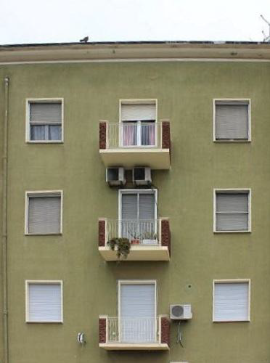
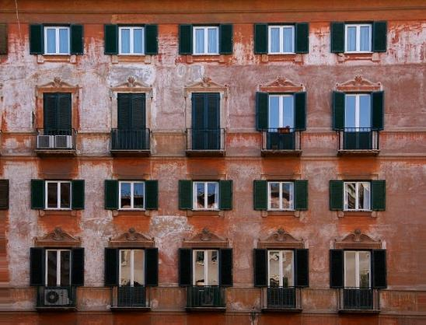
Motivation
Notes:
So for each of these static façade images, if we have their windows patterns and their configuration..

Slide 6
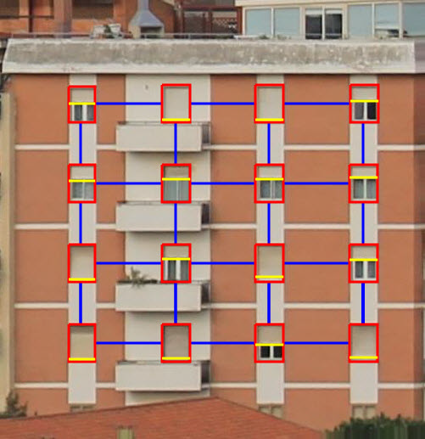
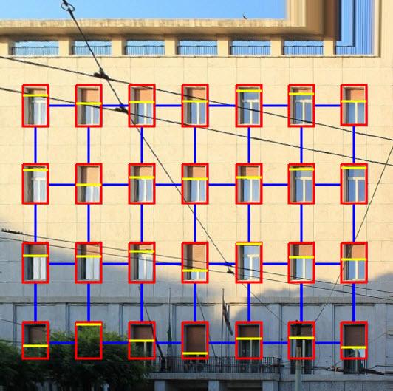
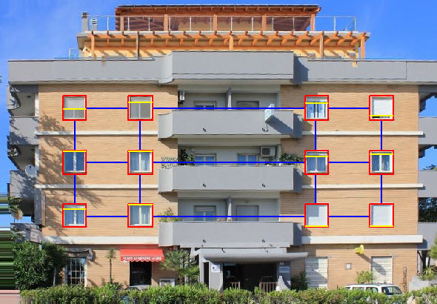
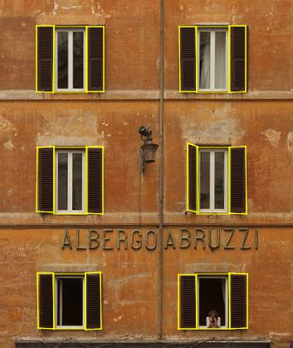
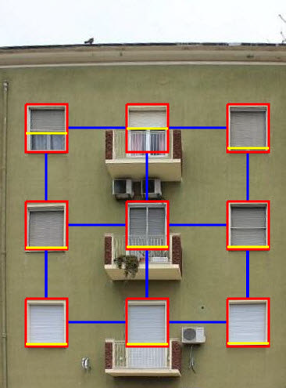
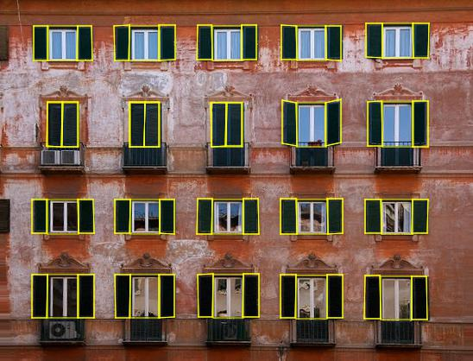
Motivation
Notes:
What interests us is, Can we bring them to life and make them interactive?

Slide 7
State of the Art
Notes:
Let’s first start with an overview of some previous work in this area

Slide 8
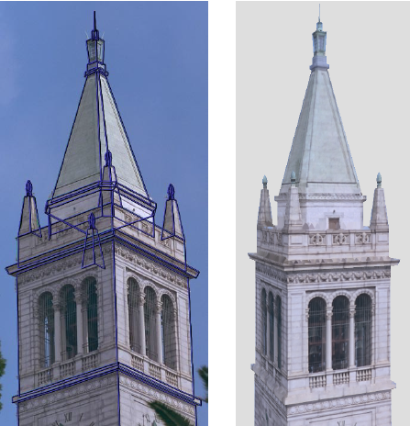
State of the Art
Image-based Modeling
Debevec et al. 1996
Notes:
Let’s first start with an overview of some of previous work in this area
Debevec and others proposed an interactive image-based modeling technique to exploit architectural objects.

Slide 9
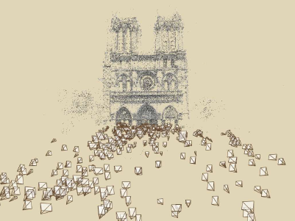
State of the Art
Image-based Modeling
Debevec et al. 1996
Snavely et al. 2006
Notes:
Structure from-motion (SfM) has been used to recover urban facades from unorganized photo collections.

Slide 10
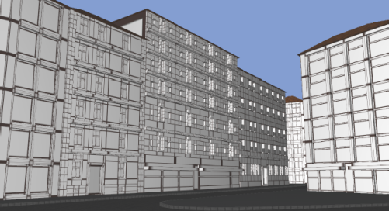
State of the Art
Image-based Modeling
Procedural Modeling
Wonka et al. 2003
Debevec et al. 1996
Snavely et al. 2006
Notes:
Procedural modeling is another approach as in the work of Wonka and others.. They used split grammars to synthesize different building styles

Slide 11
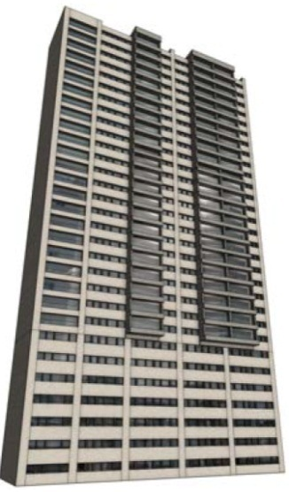
State of the Art
Image-based Modeling
Procedural Modeling
Wonka et al. 2003
Debevec et al. 1996
Snavely et al. 2006
Musialski et al. 2012
Notes:
Recently a coherence-based interactive system was proposed to support non-local operations.

Slide 12
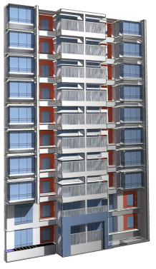
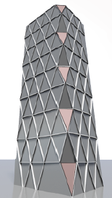
State of the Art
Image-based Modeling
Procedural Modeling
3D Geometry Synthesis
Wonka et al. 2003
Li et al. 2011
Ceylan et al. 2012
Debevec et al. 1996
Snavely et al. 2006
Musialski et al. 2012
Notes:
Also, Multiple data sources (e.g., photographs, LiDAR scans, aerial images) have been combined to improve the quality of 3D models

Slide 13
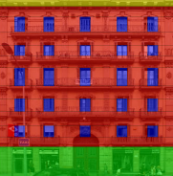
State of the Art
Image-based Modeling
Procedural Modeling
3D Geometry Synthesis
Wonka et al. 2003
Li et al. 2011
Ceylan et al. 2012
Debevec et al. 1996
Facade Annotations
Teboul et al.
2011
Snavely et al. 2006
Musialski et al. 2012
Notes:
Teboul and others addressed façade annotations by using recursive binary split grammar and reinforcement learning to parse facades elements

Slide 14
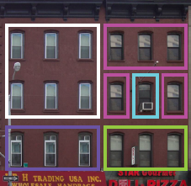
State of the Art
Image-based Modeling
Procedural Modeling
3D Geometry Synthesis
Wonka et al. 2003
Li et al. 2011
Ceylan et al. 2012
Debevec et al. 1996
Facade Annotations
Teboul et al.
2011
Alsisan and Mitra
2012
Snavely et al. 2006
Musialski et al. 2012
Notes:
In a related attempt to our work, Alsisan and Mitra swap windows to maximize image space repetitions towards efficient abstraction. however, they do not handle allowable deformations and hence inherit the typical problems of other regularity detection approaches

Slide 15
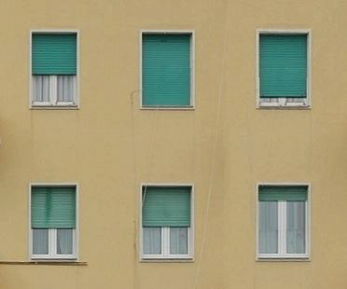
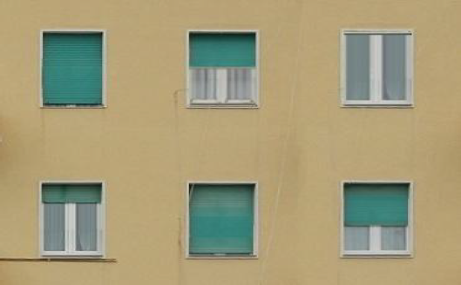
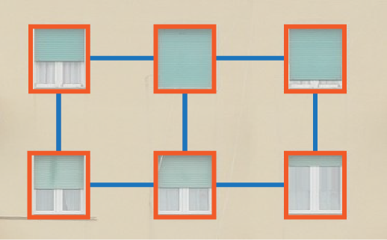
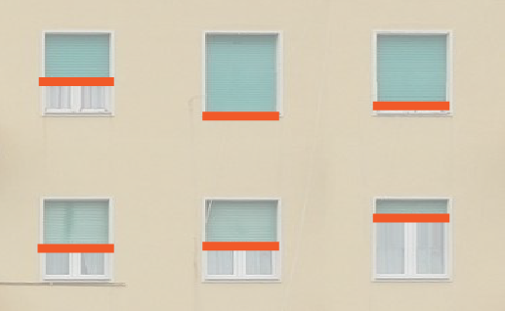
Overview
rectified image
edited image
structure analysis
element analysis
element synthesis
Notes:
(Overview)
Our main goal is to decouple repetitions from element-level variations in facade images..
Let’s see step by step how we implement it..

Slide 16
Overview
rectified image
edited image
structure analysis
element analysis
element synthesis
Notes:
After detecting the window parameters, we bring all the windows to an arbitrary but canonical position
And again perform facade structure analysis, and iterate. ..
We typically perform 2-3 iterations in our tests.

Slide 17
Overview
rectified image
edited image
structure analysis
element analysis
element synthesis
Notes:
After detecting the window parameters, we bring all the windows to an arbitrary but canonical position
And again perform facade structure analysis, and iterate. ..
We typically perform 2-3 iterations in our tests.

Slide 18
Overview
rectified image
edited image
structure analysis
element analysis
element synthesis
Notes:
(Overview)
Our main goal is to decouple repetitions from element-level variations in facade images..
Let’s see step by step how we implement it..

Slide 19
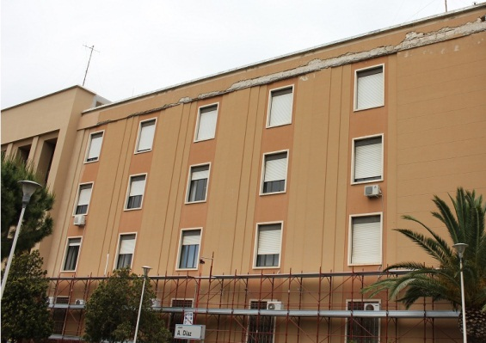
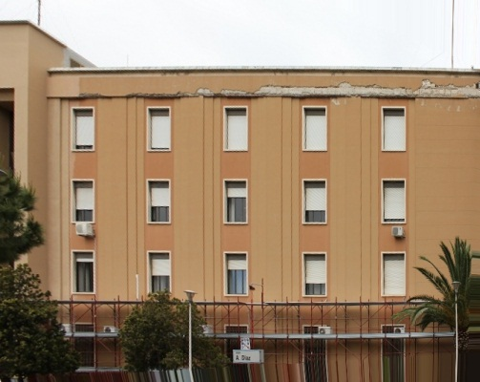
Pre-Processing
Image rectification, Wu et al. 2010
Notes:
In order to prepare the input images for analysis,
We first rectify images to front view using vanishing line proposed by Wu.

Slide 20
User input
rectified image
edited image
structure analysis
element analysis
element synthesis
Notes:
Starting from a single rectified facade image with the user marking of a single window element to identify the scale of interest

Slide 21
Structure Analysis
rectified image
edited image
structure analysis
element analysis
element synthesis
Notes:
We go to the structure analysis stage where we detect the repeated elements

Slide 22
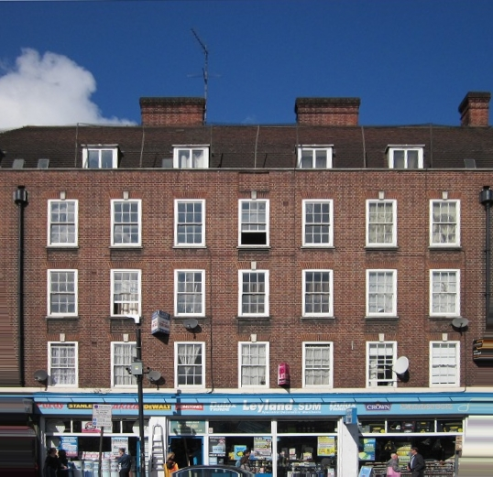
Repetition Detection
Notes:
Given the user marked dominant window mask

Slide 23
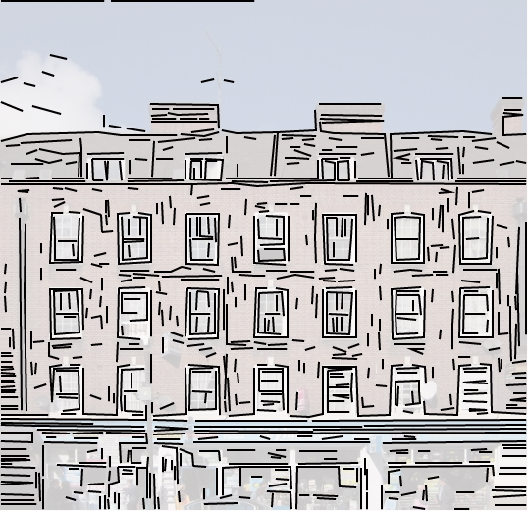
Repetition Detection
+ 𝜆
texture-based similarity
edges similarity
Notes:
we search and extract a large set of candidate repeated elements based on a score value that evaluates texture-based similarity and edge consistency

Slide 24
Repetition Detection
Texture-based similarity
Normalized Cross Correlation (NCC)
Notes:
We compute color intensity using normalized cross correlation to compare a candidate patch with the template (gray value?)

Slide 25
Repetition Detection
Texture-based similarity
Edges similarity
$$w_{edge}= \sum_{i_{i}∈W_{s}, l_{j}∈W_{t}}{match\left(l_{i}, l_{j}\right)/\left|W_{s}\right||W_{t}|}$$
Normalized Cross Correlation (NCC)
Notes:
For edges, we develop a measurement for corresponding edge matching in two patches.

Slide 26
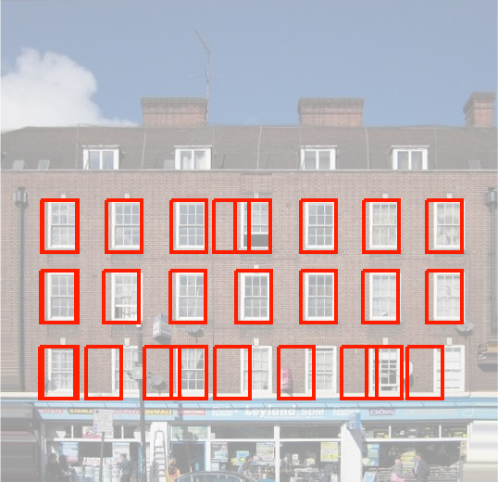
Repetition Detection
potential windows positions
Notes:
Here we have a set of the detected candidate window positions, however, as can be seen from the figure, only depending on the two terms can lead to wrong entries:
For example in case of shadows or different interior elements, intensity similarity produces errors;
varying window element configurations (window opening) lead to incorrect edge similarity.

Slide 27
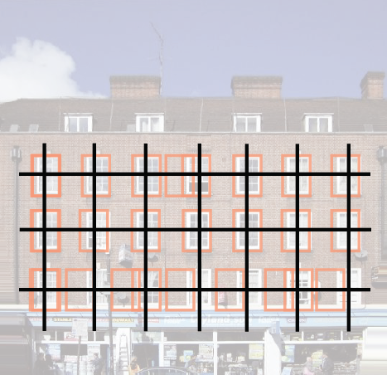
Repetition Structure Optimization
Notes:
We recover from such errors using a repetition maximizing optimization to prune wrong candidates and extract the near regular structure of the façade
We look for consistent splitting lines to define the structure grid
How does this optimization work

Slide 28
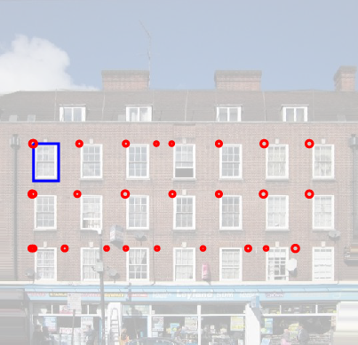
Repetition Structure Optimization
Notes:
Let the red circles here denote the locations of the candidate windows
Since we look for horizontal and vertical splits, We solve for the x and y directions independently
and their size reflects the confidence weight of each location (not needed!)

Slide 29
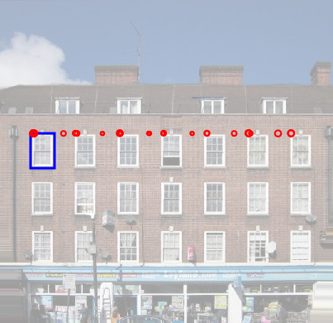
Repetition Structure Optimization
set of projected points
Notes:
Therefore, we first project these locations onto the x axis
Every point defines a potential splitting line position
Our goal is to select a subset of k splits that best explains the observations while maximizing regularity

Slide 30
Repetition Structure Optimization
set of projected points
$$\min_{S}{E\left(S\right)≔E_{data}\left(S\right)+λ E_{regularity}\left(S\right)}$$
Notes:
We measure the fitness of a valid set (whose points don’t overlap) by computing its energy as a combination of data term and no-local regularity term

Slide 31
Repetition Structure Optimization
Data Term
$$E_{data}\left(S\right)= \sum_{i=1}^{k}{1/(w_{i} . g_{i})}$$
$$g_{i}\left(S_{i}\right)= \sum_{p_{j}∈P}{exp⁡(−\frac{{\left|\left|q_{i}−p_{i}\right|\right|}^{2}}{2σ^{2}})}$$
Notes:
$σ$:width/height of the template $w_{s}$
data term evaluates the set coverage of all the points
How well the points q in S agree with other points p in P

Slide 32
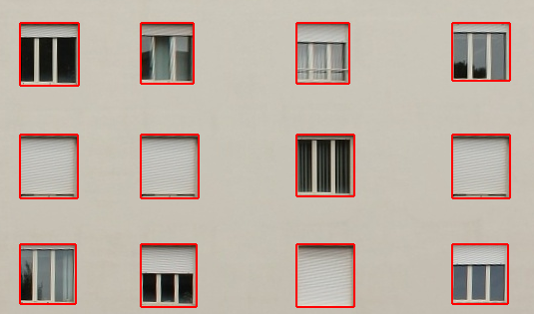
Repetition Structure Optimization
Data Term
Regularity Term
$$E_{data}\left(S\right)= \sum_{i=1}^{k}{1/(w_{i} . g_{i})}$$
$$E_{reg}\left(S\right)= \sum_{i=1}^{k−1}{{\left(d_{i}− μ\right)}^{2}+ \sum_{i=1}^{k−2}{{\left(d_{i+1}−d_{i}\right)}^{2}}}$$
$$g_{i}\left(S_{i}\right)= \sum_{p_{j}∈P}{exp⁡(−\frac{{\left|\left|q_{i}−p_{i}\right|\right|}^{2}}{2σ^{2}})}$$
Notes:
$d_{i}$: spacing
$μ$: average s
The regularity term measures the regularity of the set of points against all the potential position.

Slide 33
Repetition Structure Optimization
set of projected points
$$\min_{S}{E\left(S\right)≔E_{data}\left(S\right)+λ E_{regularity}\left(S\right)}$$
Optimization
Notes:
we use a simulated annealing based sampling in order to search the optimal subset
defining the splitting lines

Slide 34
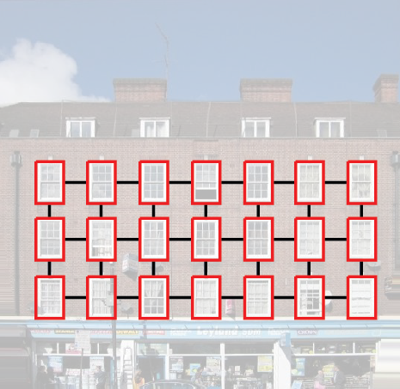
Repetition Structure Optimization
set of projected points
detected pattern
$$\min_{S}{E\left(S\right)≔E_{data}\left(S\right)+λ E_{regularity}\left(S\right)}$$
Optimization
Notes:
By minimizing this energy function, we identify the set of points specifying the splitting lines positions
and by solving for x and y directions, we obtain the structure in the façade image

Slide 35
Element Analysis
rectified image
edited image
structure analysis
element analysis
element synthesis
Notes:
Having identified the repeated windows, we can perform a per element analysis to recover its deformation parameter

Slide 36
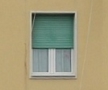
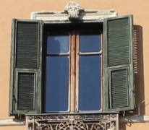
Element Analysis
Blind-type windows
Shutter-type windows
Notes:
We make some observations about windows that typically have low degrees of freedom:
(i) There are windows with blinds that slide to open vertically or horizontally, which means that the changes are approximately on the facade plane and hence can be analyzed directly on the rectified images
(ii) There are windows with shutters that rotate to open, and hence need to be analyzed using rough 3D information and back projected on the image

Slide 37
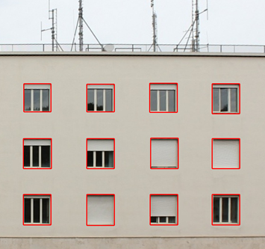
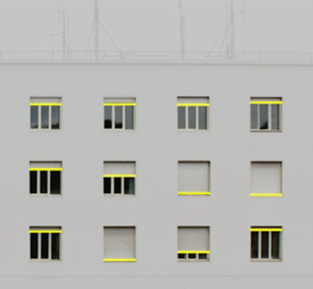
Sliding Window Analysis
…
detected windows
estimated configurations
Notes:
Lets first start with the windows with blinds.. given the detected grid, how can we extract the deformation parameters
(No need!)
either automatically, or based on user hints (e.g., roughly
marking a frame of a glass window).

Slide 38
Sliding Window Analysis
Window configurations
t=0
t=0.5
t=1
Notes:
Each window can have its independent configuration of blind.
Which is evaluated as the ratio between the blind area and the window area
and it ranges between 0 and 1, that is, 0 means a completely open blind to 1 completely closed

Slide 39
Sliding Window Analysis
Blind area estimation
Notes:
Given the window elements, we start by detecting edges on each window using Canny operator

Slide 40
Sliding Window Analysis
Blind area estimation
Notes:
And enumerate the number of edge pixels per row to extract dominant horizontal edges… by picking the rows with the maximum local number of pixels

Slide 41
Sliding Window Analysis
Blind area estimation
Notes:
This divides each window into vertically aligned sub-regions which we compute their average color to get a set of mask images
each line is associated with a top and bottom color

Slide 42
Sliding Window Analysis
Blind area estimation
Notes:
We then look across the extracted masks across multiple windows to determine consistent blind and interior colors and use them to reclassify regions for each window (fourth column).

Slide 43
Sliding Window Analysis
Blind area estimation
Notes:
Finally, we use the information to extract the respective blind parameter for each window

Slide 44
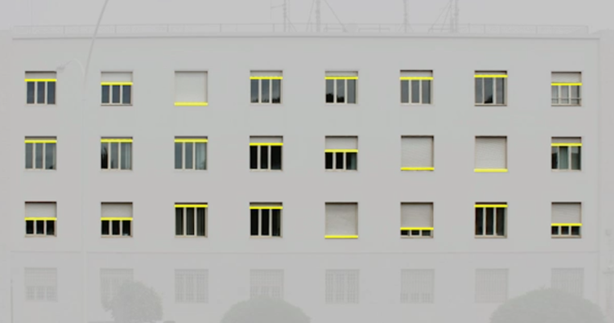
Window Configurations

Slide 45
Window Shutter Analysis
Window configurations
𝜭 ∊ [0, $π$]
Notes:
In the case of windows with rotating shutters, the parameter is defined as the rotation angle between one shutter and the façade plane

Slide 46
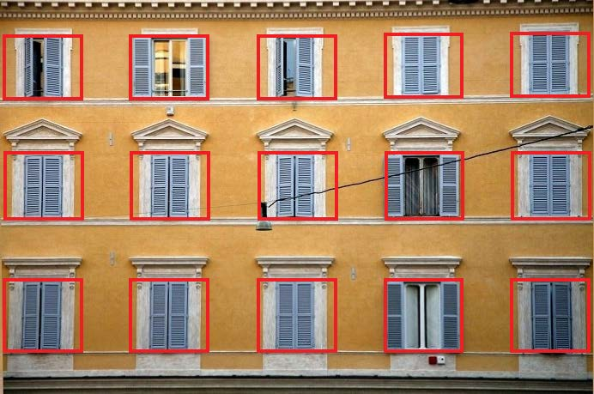
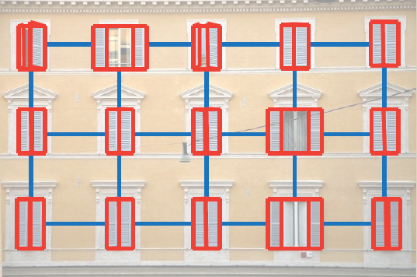
Window Shutter Analysis
Window shutter estimation
…
detected windows
estimated configurations
Notes:
Similarly, we have the positions of the repeated windows and we want to estimate their opening configurations

Slide 47
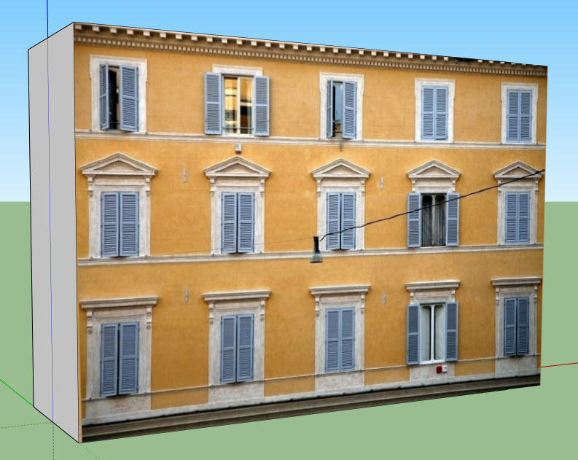
Window Shutter Analysis
Estimated 3D façade plane [Wu et al. 2011]
Notes:
Since the shutter rotations are off the facade plane
we need rough 3D information to estimate the façade plane which we obtain using the method proposed by Wu et al. [WFP11].

Slide 48
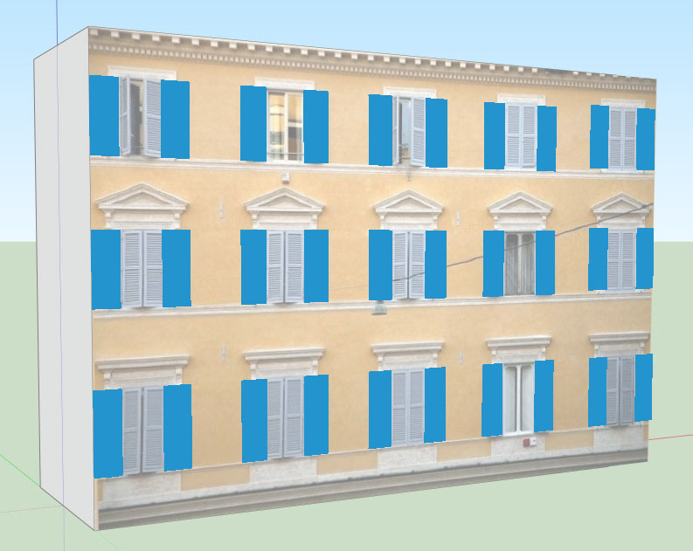
Window Shutter Analysis
Initial window placement in 3D
Notes:
We then lift the extracted 2D grid obtained in the analysis stage to get initial window placements in 3D with corresponding size in World coordinate

Slide 49
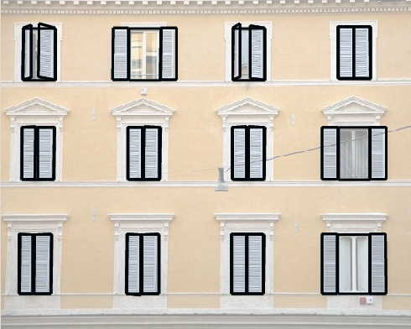
Window Shutter Analysis
𝜭 ∊ [0, $π$]
projected 3D windows
Notes:
We consider the left and right shutters independently.. Each shutter is represented as a 3D rectangle
we rotate the shutter by an angle ˆq and apply the projective transformation from 3D -> 2D image
which will map the 3D rectangle into a quad region on the image

Slide 50
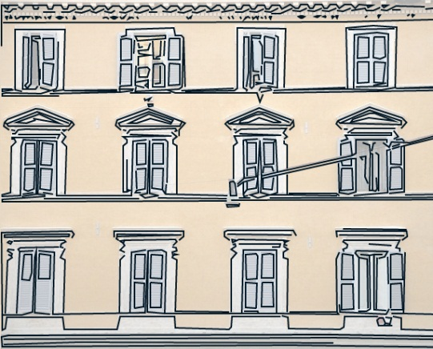
Window Shutter Analysis
𝜭 ∊ [0, $π$]
projected 3D windows
2D edges
2D-3D line matching
Notes:
Given the detected edges on the image, we perform 2D-3D line matching

Slide 51
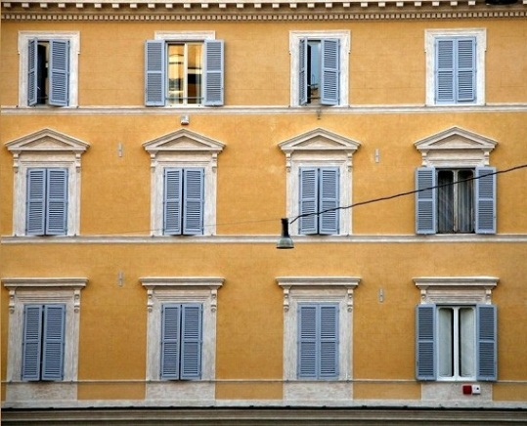
Window Shutter Analysis
𝜭 ∊ [0, $π$]
+
projected 3D windows
2D edges
input image
2D-3D line matching
color
Notes:
And we incorporate color information to find the angle that maximizes color and edge (2D-3D line matching) similarity

Slide 52
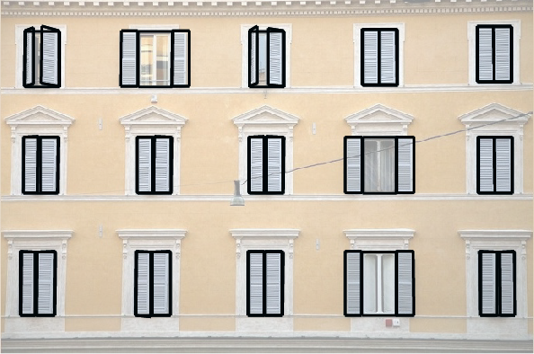
Window Configurations

Slide 53
Analysis Iteration
rectified image
edited image
structure analysis
element analysis
element synthesis
Notes:
After detecting the window parameters, we bring all the windows to an arbitrary but canonical position
And again perform facade structure analysis, and iterate. ..
We typically perform 2-3 iterations in our tests.

Slide 54
Element Synthesis
rectified image
edited image
structure analysis
element analysis
element synthesis
Notes:
We now describe how we use the extracted repetition pattern and window configurations to fill in missing information in background layers and unknown window regions,
eventually leading to a factored facade representation.

Slide 55
Background Layer
detected windows
Notes:
In order to define the background wall layer, we first remove the frames of the detected windows.
And then use PatchMatch-based [BSFG09] image completion to get the complete background..
How to say!! (NO NEED!)
Using structuring guidelines, where we prefer information propagation
vertically since windows have a reflective symmetry. ????????!!!!!!!!!!!!!

Slide 56
Background Layer
detected windows
remove windows

Slide 57
Background Layer
detected windows
…
remove windows
image completion
Notes:
And then use PatchMatch-based [BSFG09] image completion to get the complete background..
Using structuring guidelines, where we prefer information propagation vertically since windows have a reflective symmetry. (NO NEED for this to say!)

Slide 58
Blind Synthesis
t=0
t=0.2
Observed windows
t=0.4
t=0.6
t=0.8
t=1
synthesis results
Notes:
Next, we use the set of window elements with the corresponding blind parameters to synthesize new windows with arbitrary blind configurations
We note that while the window backgrounds typically capture building interiors, the windows (i.e., blinds) are repeated and missing regions for one window can be filled in using information from other repeated (more) closed windows. (how?)

Slide 59
Blind Synthesis
Graph-cut based formulation
input windows
implicit correspondence
Notes:
since we know the opening parameters of the repeated windows, we implicitly have correspondence information across them. We exploit this implicit correspondence to solve a graph-cut based formulation for image completion and consolidation….
using information across the repeated window blinds.
The synthesis involves two tasks:
filling in the missing regions for the background and
filling in the missing regions for the windows (if they are in partially open positions).

Slide 60
Shutter Synthesis
𝜭 ∊ [0, $π$]
input image
edited image
Notes:
In the case of shutter windows, we sample a discrete set of angles to synthesize textures for intermediate angle values.
Since we have a simple proxy geometry as the window rectangle in 3D, we directly bring the windows (in space of rotations) to target configuration q and interpolate.

Slide 61
Factored Façade Encoding
input image
repetition pattern
opening parameters
background layer
Notes:
We can now define the factored façade representation where a façade image is encoded by:
the rectifying transform;
the repetition grid along with which of the elements are occupied;
the opening parameters for each window along with synthesized open/closed positions;
the background layer.
MENTION ADVANTAGES

Slide 62
User Editing
rectified image
edited image
structure analysis
element analysis
element synthesis
Notes:
Having the factored façade representation allows for many editing operations on the façade image

Slide 63
Interactive Façade Images
demo
Notes:
We have implemented a basic user interface to interactively synthesize new facade images based on the recovered factored facade representations (see
demo and video). The main functionalities are:
Repetition restructuring. We allow the user to interactively change the grid structure of the repetitions and reposition a specified element. During the relocation, all the
elements in the same row/column are updated while preserving alignment (see also [WWF10]).
Window blind synthesis. The user can interactively change the positioning of a window blind by dragging the bottom edge of the blind up and down in the original facade view.
Window shutter synthesis. The orientation of the window shutters can be specified interactively.

Slide 64
More Results
rectified image
detected structure
Notes:
Stop & explain

Slide 65
More Results
rectified image
detected structure
synthesis results
Notes:
Stop & explain

Slide 66
More Results
rectified image
detected structure
synthesis results

Slide 67
Summary
rectified image
edited image
structure analysis
element analysis
element synthesis
Notes:
Our goal is to decouple repetitions from element-level variations in facade images..
Starting from a single rectified facade image with the user marking of a single window element
our framework performs structure analysis to extract the repetition pattern
Which is further analyzed to estimate deformation parameters for each window.
Then, we revisit the structure analysis to refine the detected pattern based on the estimated window parameters..
Next, we perform corresponding image completion to synthesize window elements..

Slide 68
User interaction
User assistance
rectified image
edited image
structure analysis
element synthesis
Notes:
The user is involved mainly at 3 places in our work:
initially, the user marks a single window element to specify scale of interest… In case of facades with multiple element types, the user marks several elements
during facade element analysis, the user marks a frame-mask with rough strokes only when the window frame has transparent glass;
(iii) during interactive facade application, the user directly manipulates the factored facade representation to synthesize new facade images. (see supplementary video and demo application)
(? The missing script) Finally, we use the extracted factored representation to enable syntax preserving interaction and synthesis possibilities.

Slide 69
Applications
MVS
Variation Factored MVS
Notes:
Using structure from motion (SfM) and multi view stereo (MVS) to reconstruct 3D data from a series of 2D images is very popular, however,
The quality of the reconstructed data directly depends on the feature correspondences across images.
Usually façade elements such as windows contain more details and are better candidate for feature correspondences than walls.
But the variations caused by changes in element configurations pose challenges for SfM based reconstructions.
For example when we apply the patch-based MVS algorithm of Furukawa et al. [FP09] on synthetic scenes with facade element variations we obtain poor results
Instead, after recovering the window deformation parameters for each image, we bring the windows to a canonical position in all the images and use them as input
for the MVS algorithm. We observe that the reconstruction quality is significantly better.

Slide 70
Applications
Procedural generation of 3D facades
input image
3D model
synthesized windows
Notes:
We can procedurally generate a facade model as a 3D counterpart of the input 2D facade image while taking into account the element level Deformations
TITLE!!

Slide 71
Applications
Façade-syntax preserving synthesis
Notes:
As well, the repetition elements can be replaced… by new elements
In this example, we switch window elements in the two façade images

Slide 72
Limitations
Notes:
Some of the limitations that we have
(i) Large scale window element variations can result in failure in the
initial repetition detection preventing the algorithm to proceed;
(ii) significant light/shadow variations, or presence of outlier elements, can also lead to failure to abstract the window
variations or even miss the repetition grids; and
(iii) Cultural differences across window types can result in failures.

Slide 73
Limitations
large-scale variations
Notes:
Some of the limitations that we have
(i) Large scale window element variations can result in failure in the
initial repetition detection preventing the algorithm to proceed;

Slide 74
Limitations
large-scale variations
significant shadows or outliers
Notes:
(ii) significant light/shadow variations, or presence of outlier elements, can also lead to failure to abstract the window
variations or even miss the repetition grids; and

Slide 75
Limitations
large-scale variations
significant shadows or outliers
window types
Notes:
(iii) Cultural differences across window types can result in failures.
In the next step, we would like to investigate a more tightly coupled repetition detection and window variation estimation …

Slide 76
Future Work
appearance modeling effects
Notes:
Also, the 3D proxy geometries can be used towards more accurate appearance modeling effects under known light and camera settings (see also [ZCC12]).

Slide 77
Future Work
appearance modeling effects
interesting image parts
Notes:
Finally, the recovered window templates (with allowed variations) can be used to reveal interesting image parts, which cannot be explained by extracted window templates, leading to novel image understanding possibilities (how?)

Slide 78
Acknowledgments
Duygu Ceylan
Suhib Alsisan
Charlotte Rakhit
Marie Curie Career Integration Grant 303541
Notes:
We would like to thank
Duygu Ceylan for her many good suggestions and constant encouragement
Suhib Alsisan for initial discussion on the topic
Charlotte Rakhit for video voiceover.
The work was partially supported by the Marie Curie Career Integration Grant

Slide 79
Supplementary Materials
Demo/Code/Supplementary data on the project web page.
http://vecg.cs.ucl.ac.uk/Projects/SmartGeometry/interactive_facades/interactiveFacades_eg13.html
Notes:
Welcome to view the supplementary data on our web page

Slide 80
Thank you!

